Slide 1
MAY 4-11
K-5 LAST NTI WEEK

Slide 2
National Standards grades 3-5
MU:CR1.1.3a.4a.5a Improvise rhythmic, melodic, and harmonic ideas and explain connection to purpose and context such as social cultural and historical
MU:Cr 1.1.3a.4a.5b Generate musical ideas such as rhythms, melodies, and accompaniment patterns within specific related tonalities, meters, and simple chord changes.
MU:Cr2.1.3a.4a.5a Demonstrate selected and developed musical ideas for improvisations, arrangements, or compositions to express intent, and explain connection to purpose and context.
MU:Cr2.1.3a.4a.5b Use standard and/or iconic notation and/or recording technology to document personal rhythmic, melodic, and two-chord harmonic musical ideas.

Slide 3
Learning Target - NTI Instruction
I can explore a variety of Digital Music Resources to create music and reinforce elements of music such as beat, tempo, rhythm, iconic notation and form.

Slide 4
Assessment
I can share my creations with my teacher or send a picture of my work.

Slide 5
Instructions
For the last week, Complete any assignments you still may need to do.
Remember to enjoy music!
Explore the following Music resources during the last week of NTI days.
Have Fun!

Slide 6
Chrome Music Lab
https://musiclab.chromeexperiments.com/Experiments
What is Chrome Music Lab?
Chrome Music Lab is a website that makes learning music more accessible through fun, hands-on experiments.

Slide 7
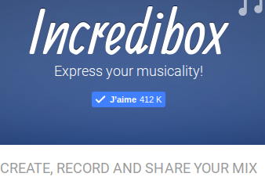
Incredibox
http://www.incredibox.com

Slide 8
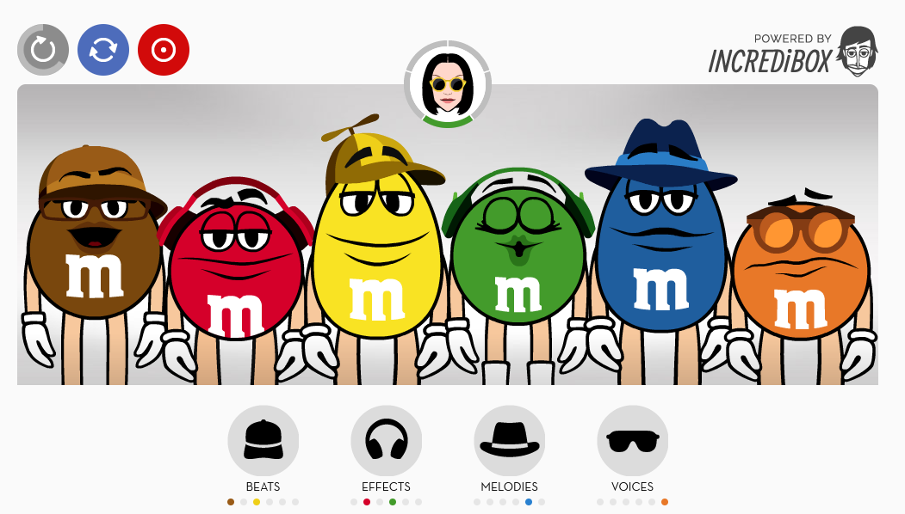
Bitesize Beats
http://www.bitesizebeats.com/

Slide 9
PBS String Thing
http://pbskids.org/designsquad/games/string_thing/index.html

Slide 10
Music Tech Teacher - Tons of Music Games
https://www.musictechteacher.com/
Click on “GAMES/QUIZZES”

Slide 11
DON’T FORGET
SHARE PICTURES OR PROJECTS WITH MS. KEAN.
ENJOY!

