Slide 1
K-5 NTI WEEK 4-6 Music Choice Board
April 13-May 1

Slide 2
National Standards grades 3-5
MU:CR1.1.3a.4a.5a Improvise rhythmic, melodic, and harmonic ideas and explain connection to purpose and context such as social cultural and historical
MU:Cr 1.1.3a.4a.5b Generate musical ideas such as rhythms, melodies, and accompaniment patterns within specific related tonalities, meters, and simple chord changes.
MU:Cr2.1.3a.4a.5a Demonstrate selected and developed musical ideas for improvisations, arrangements, or compositions to express intent, and explain connection to purpose and context.
MU:Cr2.1.3a.4a.5b Use standard and/or iconic notation and/or recording technology to document personal rhythmic, melodic, and two-chord harmonic musical ideas.

Slide 3
Learning Target - NTI Instruction
I can explore a variety of Digital Music Resources to create music and reinforce elements of music such as beat, tempo, rhythm, iconic notation and form.

Slide 4
Assessment
I can share my creations with my teacher or send a picture of my work.

Slide 5
Instructions
Explore the following Music resources during NTI days.
Complete a project,
OR explore the Music Resource
Be sure to share it with Ms. Kean
OR send a picture of yourself while using the resource.
Have Fun!

Slide 6
Chrome Music Lab
https://musiclab.chromeexperiments.com/Experiments
What is Chrome Music Lab?
Chrome Music Lab is a website that makes learning music more accessible through fun, hands-on experiments.

Slide 7
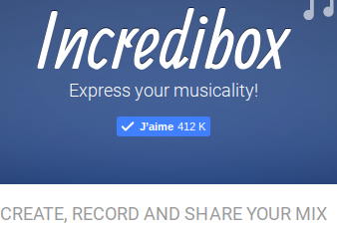
Incredibox
http://www.incredibox.com

Slide 8
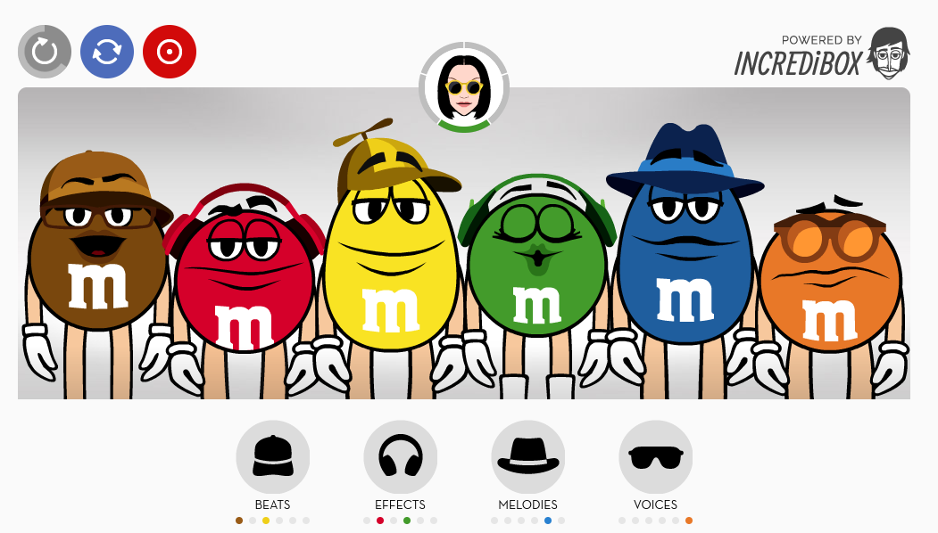
Bitesize Beats
http://www.bitesizebeats.com/

Slide 9
PBS String Thing
http://pbskids.org/designsquad/games/string_thing/index.html

Slide 10
Music Tech Teacher - Tons of Music Games
https://www.musictechteacher.com/
Click on “GAMES/QUIZZES”

Slide 11
DON’T FORGET
SHARE PICTURES OR PROJECTS WITH MS. KEAN.
ENJOY!

