Slide 1
Music
Sept 20-25
Treble Staff
Grade 3-5

Slide 2
National Standards
5th grade- MU:Cr2.1.5b Use standard and/or iconic notation and/or recording technology to document personal rhythmic, melodic, and two-chord harmonic musical ideas.
4th grade- MU:Cr2.1.4b Use standard and/or iconic notation and/or recording technology to document personal rhythmic, melodic, and two-chord harmonic musical ideas.
3rd grade - MU:Cr2.1.3b Use standard and/or iconic notation and/or recording technology to document personal rhythmic, melodic, and two-chord harmonic musical ideas.

Slide 3
Learning Target
Grades 3, 4, 5
I can identify the notes in the Treble Staff.

Slide 4
Mini-Lesson
Review Lines/Spaces of the Treble Staff

Slide 5
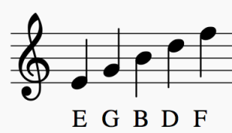
Line Notes

Slide 6
Line Notes

Slide 7
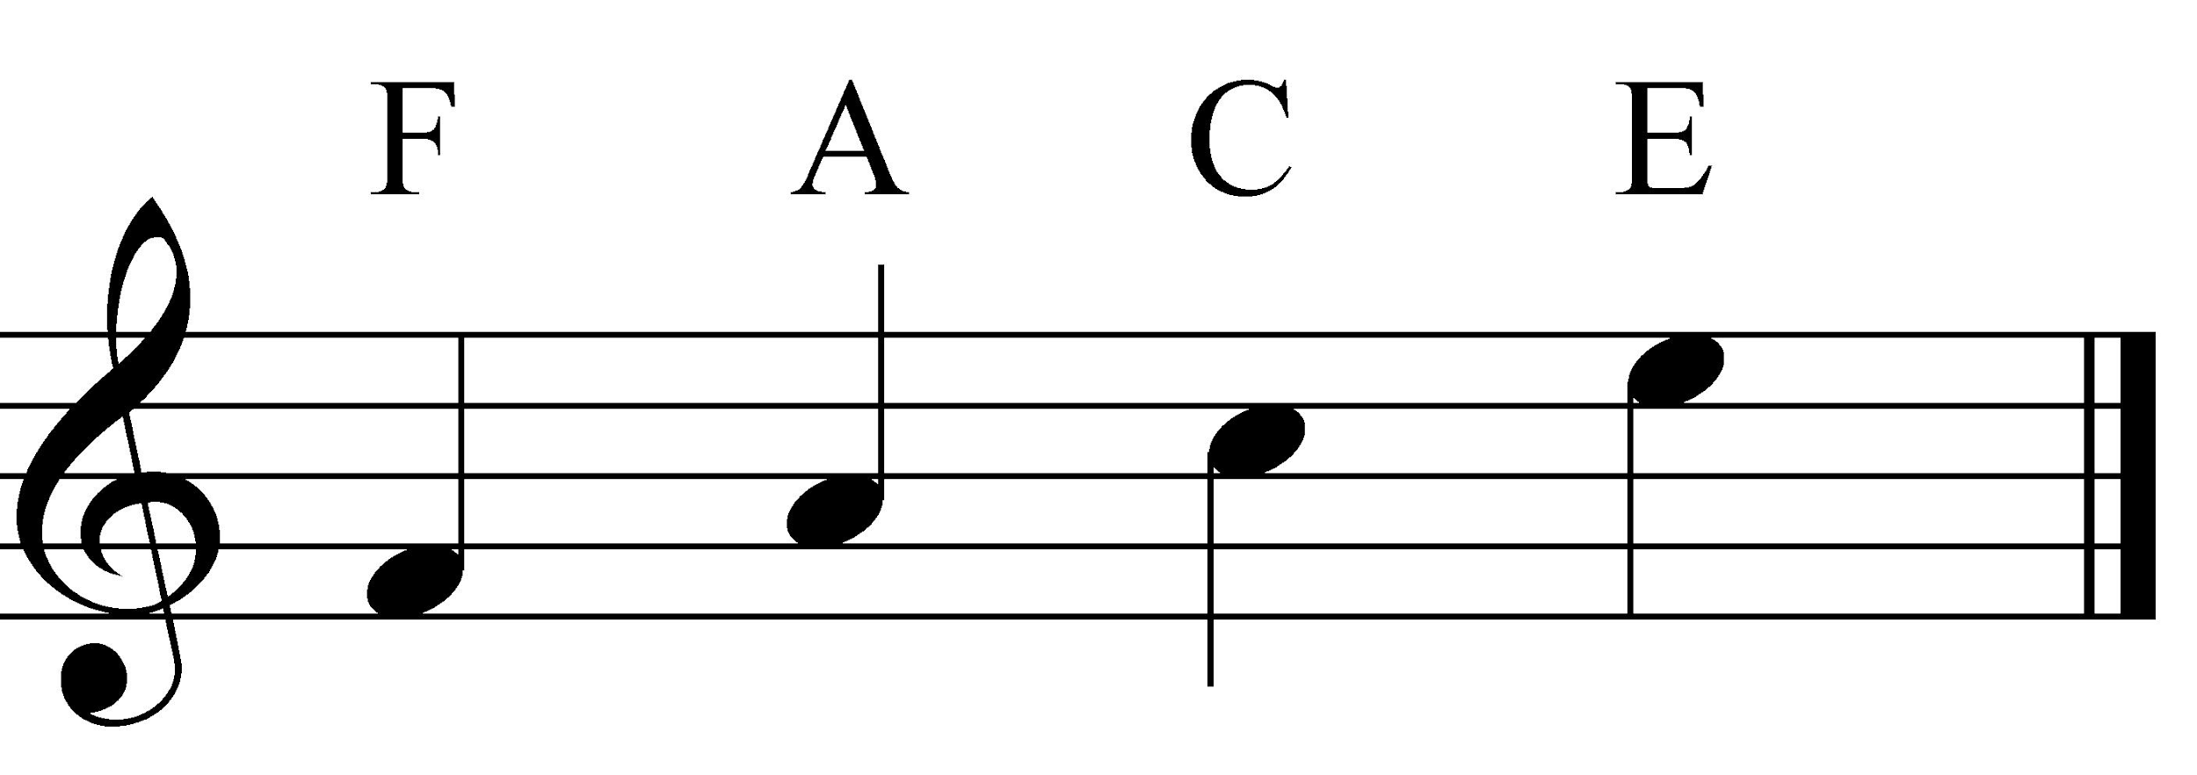
Space Notes

Slide 8
Activity
Using Chromebooks, students will use online music theory to practice Treble Staff note naming
Musictechteacher.com
Treble Clef Note Rally
Treble Clef Word Warrior
Treble Clef Sports Blaster

Slide 9
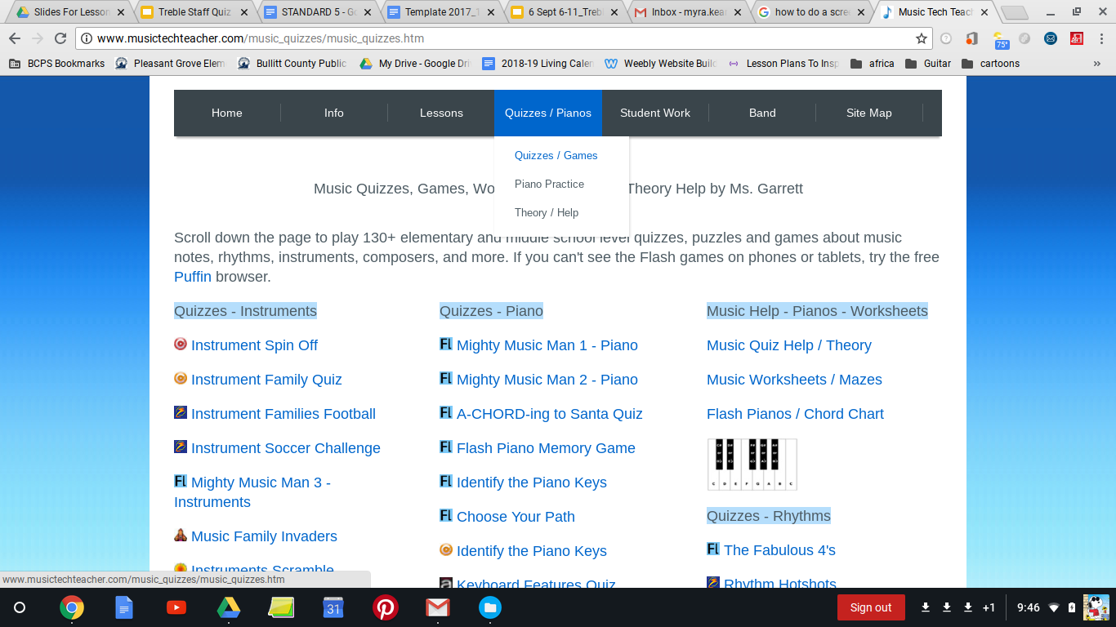
Treble Clef Note Rally

Slide 10
Directions to Students
Open GOOGLE web browser on your Chromebook
In the search bar, type in the following address:
Musictechteacher.com
3. Click top tab QUIZZES
Scroll Down and in second column Choose
TREBLE CLEF NOTE RALLY OR
TREBLE CLEF WORD WARRIOR
Treble Clef Sports Blaster

Slide 11
Assessment/Reflection
Treble Staff Exit Quiz
Handout Paper and Pencils
Put your name on your paper
Number your paper 1-16

Slide 12
Exit Slip Quiz
Name each note.
2. 3. 4. 5. 6. 7. 8. 9. 10. 11. 12. 13. 14. 15. 16.

Slide 13
Music
Sept 20-25
Treble Staff
Grade K-2

Slide 14
National Standards
Kgtn grade- MU:Cr 1.1.Ka With guidance, explore and experience music concepts such as beat and melodic contour
MU:Cr2.1.Kb With guidance, organize personal musical ideas using iconic notation and/or recording technology.
1st grade- MU:Cr2.1.1b With limited guidance, use iconic or standard notation and/or recording technology to document and organize personal musical ideas.
MU:Pr4.2.1b When analyzing selected music, read and perform rhythmic patterns using iconic or standard notation.
2nd grade - MU:Cr1.1.2a Improvise rhythmic and melodic patterns and musical ideas for a specific purpose.
MU:Cr2.1.2b
Use iconic or standard notation and/or recording technology to combine, sequence, and document personal musical ideas.

Slide 15
Learning Target
I can identify a Treble Clef and line and space notes.

Slide 16
Mini Lesson
Review Treble Clef and Lines and spaces

Slide 17
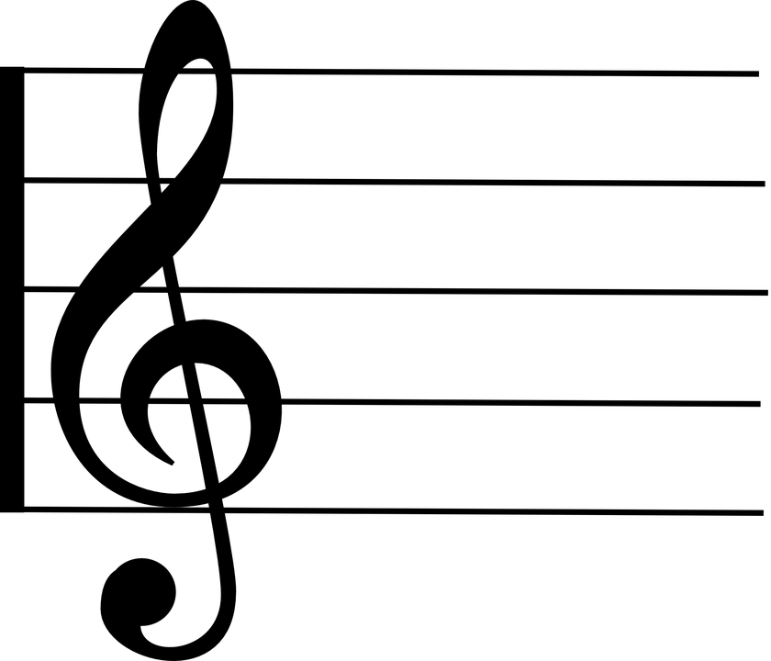
What is a Treble Clef?

Slide 18
Activities
Number the Lines using the White Board
Number the spaces using the White Board
kGARTEN - S or L Worksheet
2nd grade face worksheet
1ST - EGBDF WORKSHEET
Floor Race Game

Slide 19
Assessment/Reflection
Performance
Observation
Game
Worksheet as exit slip

