Slide 1
Music
Sept 26-Oct 9
3rd & 4th & 5th Grade
Compose Yourself Cards

Slide 2
National Standards
5th & 4th grade -
MU:Cr2.1.4a Demonstrate selected and organized musical ideas for an improvisation, arrangement, or composition to express intent, and explain connection to purpose and context.
MU:Cr2.1.4b Use standard and/or iconic notation and/or recording technology to document personal rhythmic, melodic, and simple harmonic musical ideas.
3rd grade -
MU:Cr2.1.3a Demonstrate selected and organized musical ideas for an improvisation, arrangement, or composition to express intent, and explain connection to purpose and context.
MU:Cr2.1.3b Use standard and/or iconic notation and/or recording technology to document personal rhythmic, melodic, and simple harmonic musical ideas.

Slide 3
Learning Target
I can create my own rhythmic composition, evaluate and revise it.

Slide 4
Mini-Lesson
Instructions below.

Slide 5


Compose Yourself

Slide 6

Open Google

Slide 7
2. In search bar - Type
composeyourself.thinkfun.com

Slide 8
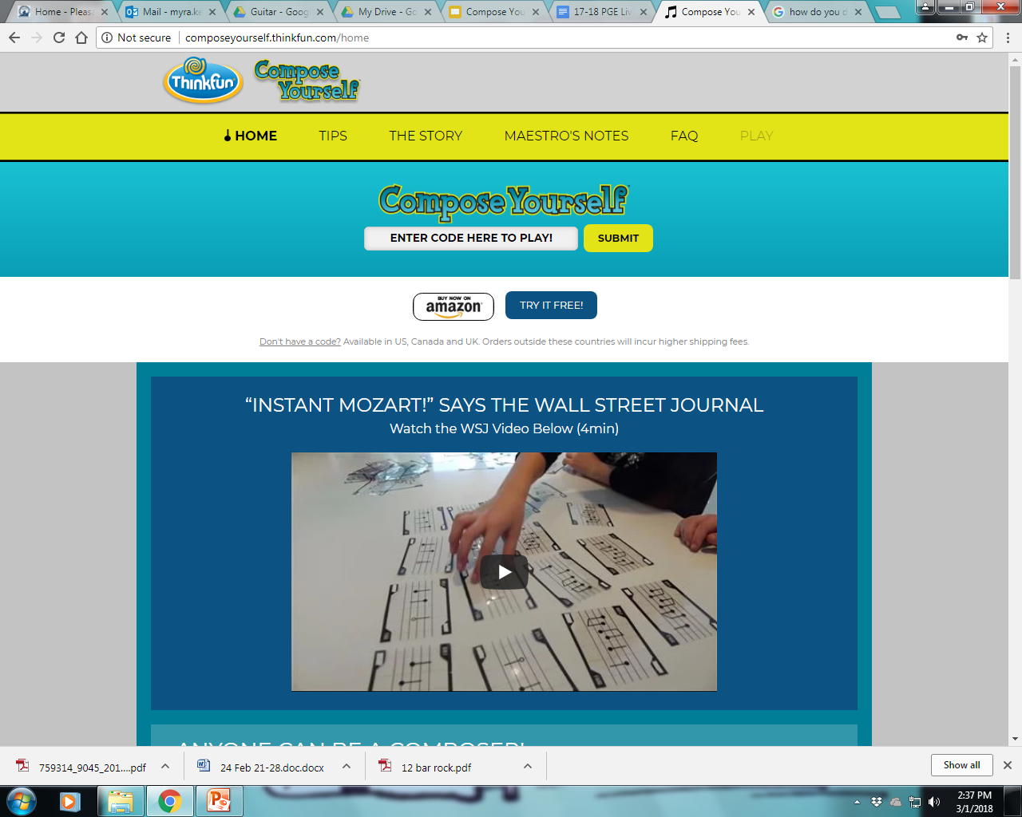
3. Enter the code in the White box (click SUBMIT)
CODE=
musicmaker

Slide 9
4. Type in your student email
Your.name@stu.bullitt.kyschools.us

Slide 10
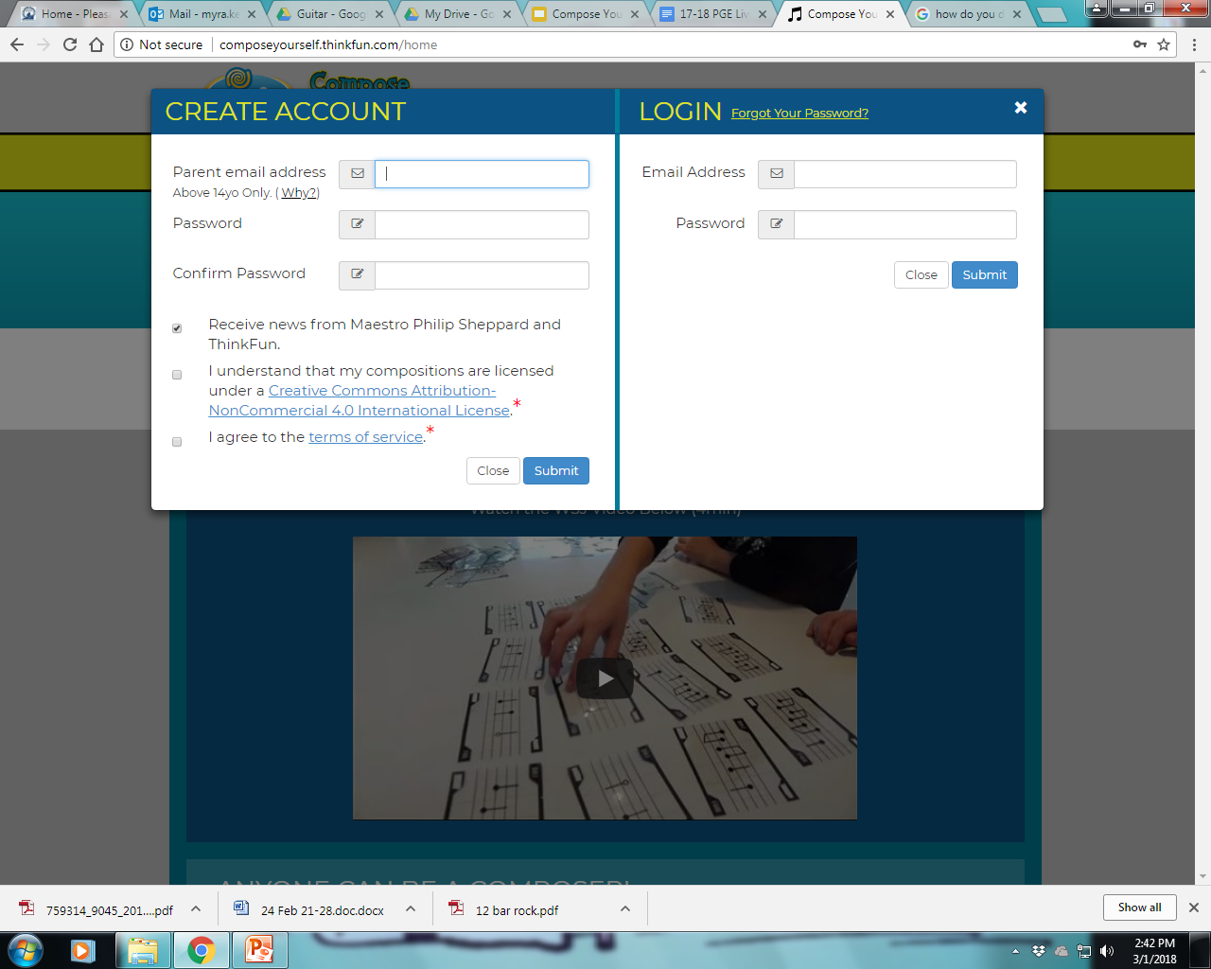
5. Everyone uses same password
PASSWORD =
pgerocks

Slide 11
6. Confirm password by typing it again
CONFIRM PASSWORD =
pgerocks

Slide 12
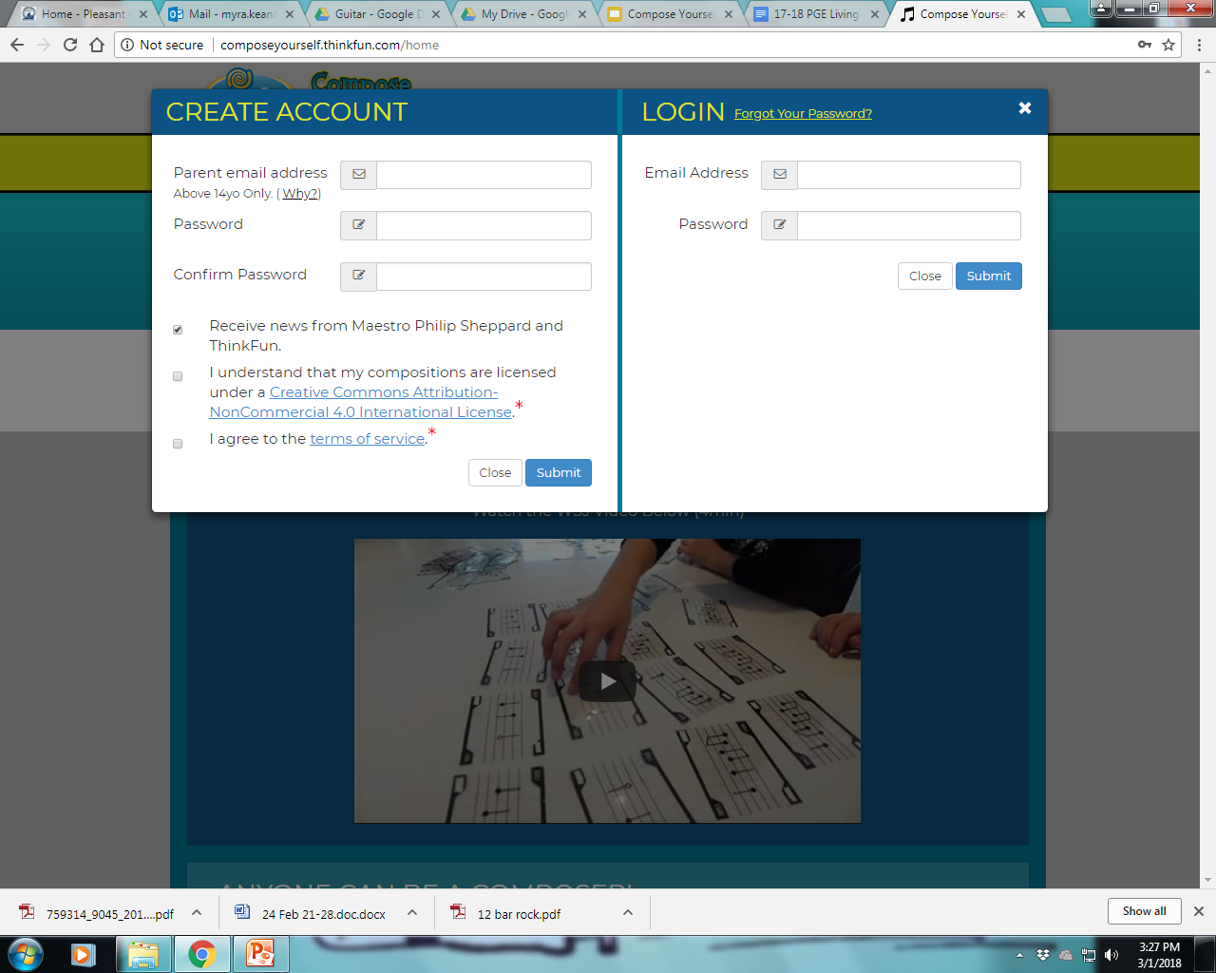
7. Uncheck the first box
UN-CHECK the first box
CHECK the bottom two boxes
Hit SUBMIT

Slide 13
Add Melody Card Codes
Enter the number of the code in the left hand corner of your melody card.
Hit submit button.

Slide 14
How to Revise or Edit
Enter your cards LISTEN. What do you like and What doesn’t sound good?
Flip a card upside down.
Flip a card left to right.
Change the placement of a card.
Use Repetition. Use a favorite card more than once
Start and end composition on same note
Change the instruments.
Change a card with a friend.
Be able to explain why you made the choices above.

Slide 15
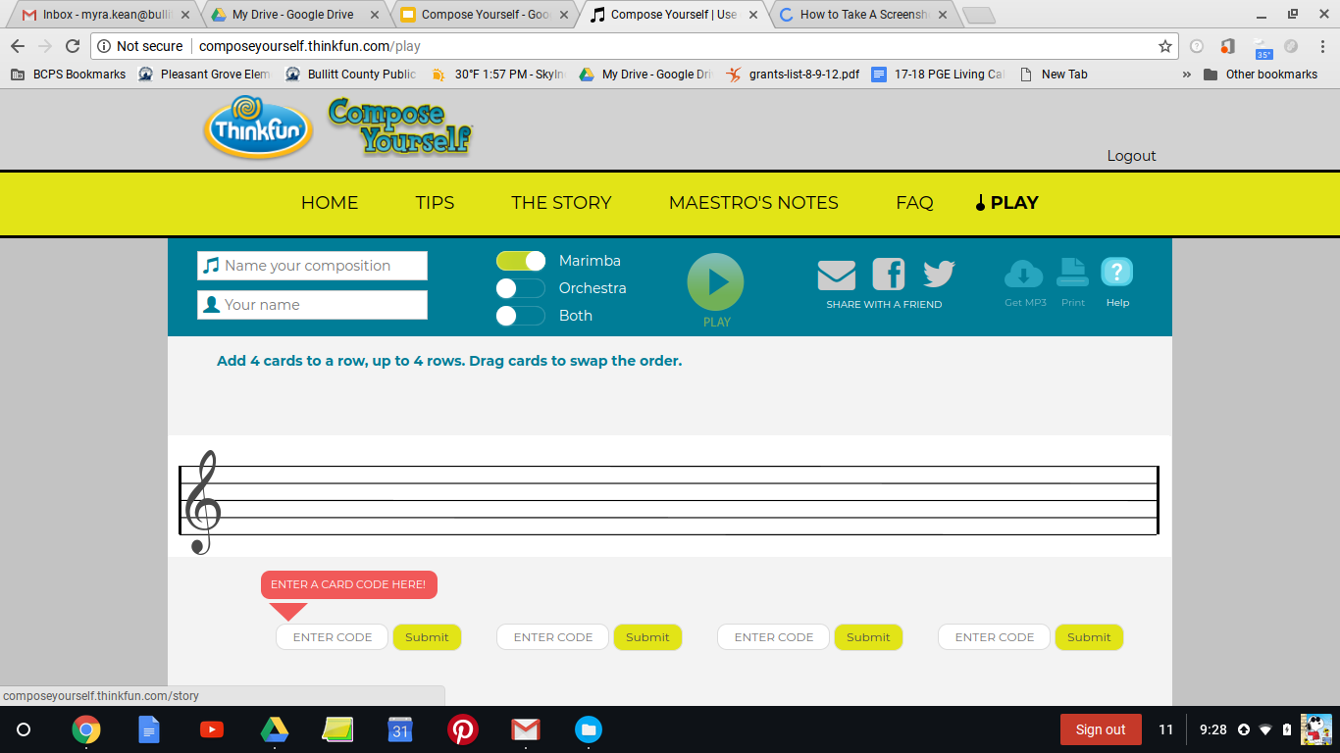
How to Save Composition
When you have a song you would like to save:
Click the envelope in top right hand corner of screen.

Slide 16
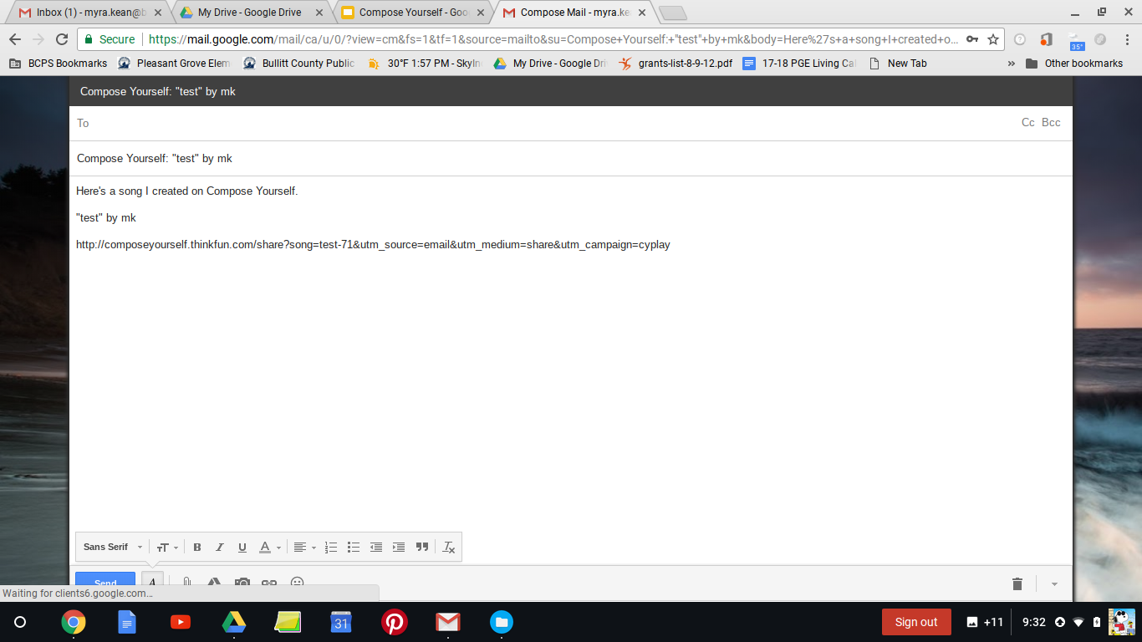
Send your composition through GMAIL
Type in YOUR email address in the address bar
Hit SEND

Slide 17
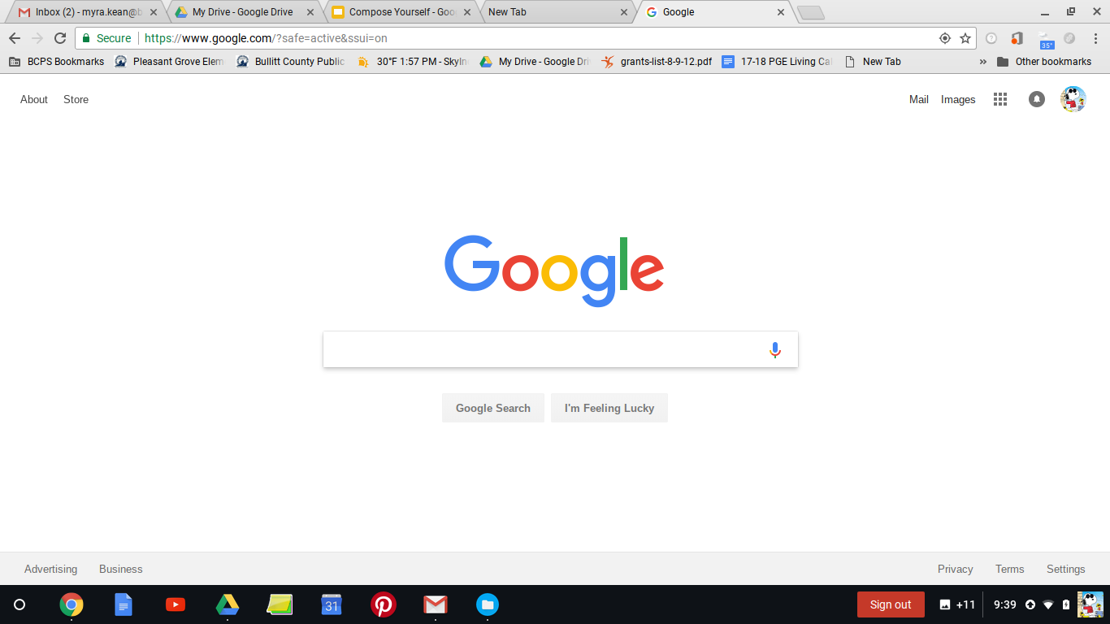
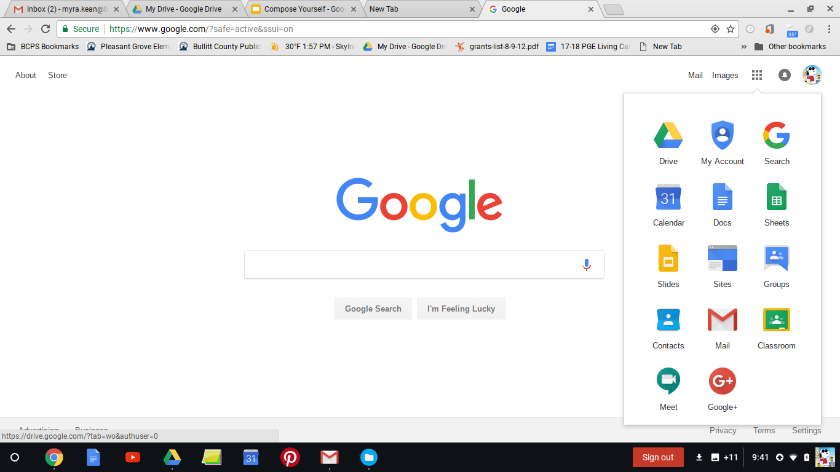
To open your email:
Open a new tab
Open the “Waffle”
Click on GMAIL
Click on your composition
to open, print or play

Slide 18
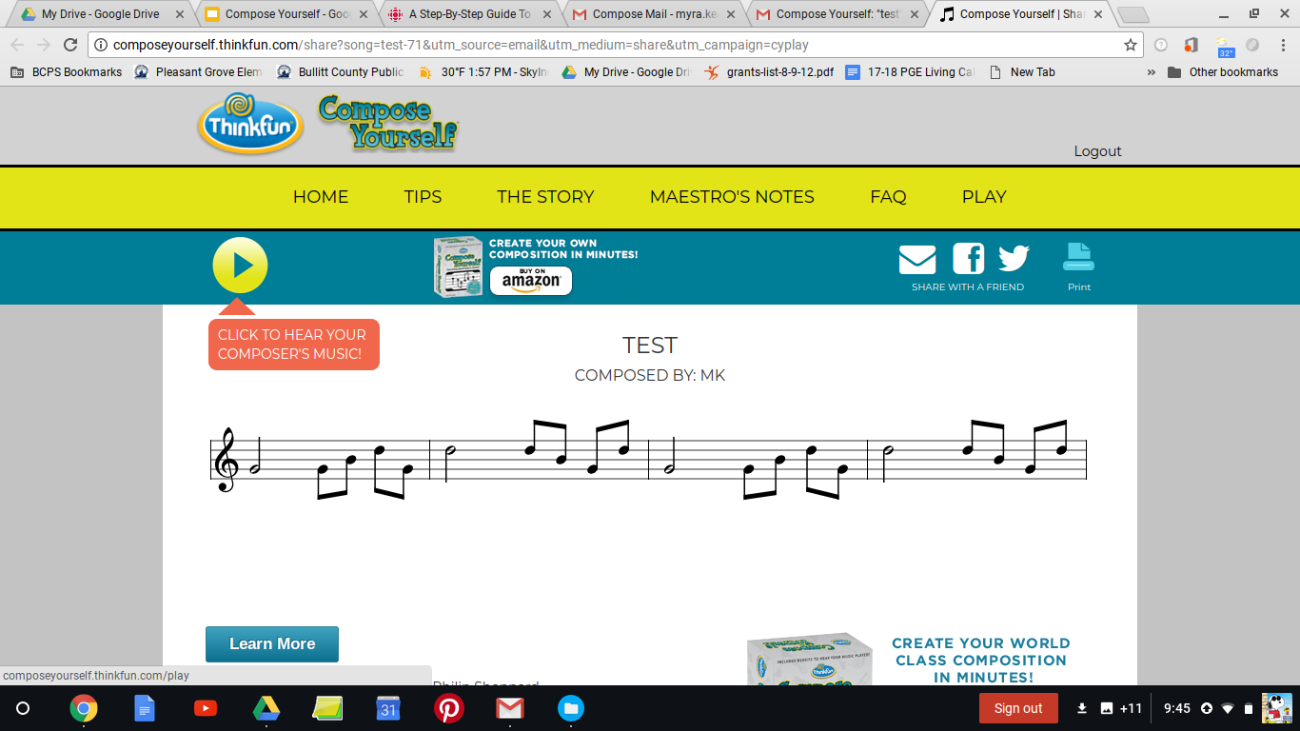

Slide 19
Music
Sept 26-Oct 9
Kgarten, 1st, 2nd Grade
Shoo Fly Xylophones

Slide 20
National Standards
Kindergarten -
MU:Cr 1.1.Ka
With guidance, explore and experience music concepts such as beat and melodic contour
MU:Cr1.1.Kb
With guidance generate musical ideas such as motives or movements
1st
MU:Cr 1.1.1a
With guidance, explore and experience music concepts such as beat and melodic contour
MU:Cr1.1.1b
With guidance generate musical ideas such as motives or movements
2nd
MU:Cr 1.1.2a
With guidance, explore and experience music concepts such as beat and melodic contour
MU:Cr1.1.2b
With guidance generate musical ideas such as motives or movements

Slide 21
Learning Target
I can sing dance and play an instrument with a folk song.

Slide 22
Mini-Lesson
Xylophone Video Expectations
Sing Shoo Fly
Watch Shoo Fly dance
Sing / dance
Add xylophone parts

Slide 23
Activity
Xylophone Video Expectations
Sing Shoo Fly
Watch Shoo Fly dance
Sing / dance in large group
Add xylophone parts in small groups
Perform

Slide 24
Assessment
Performance
Observation
Whole group
Small Group

